Slide 1
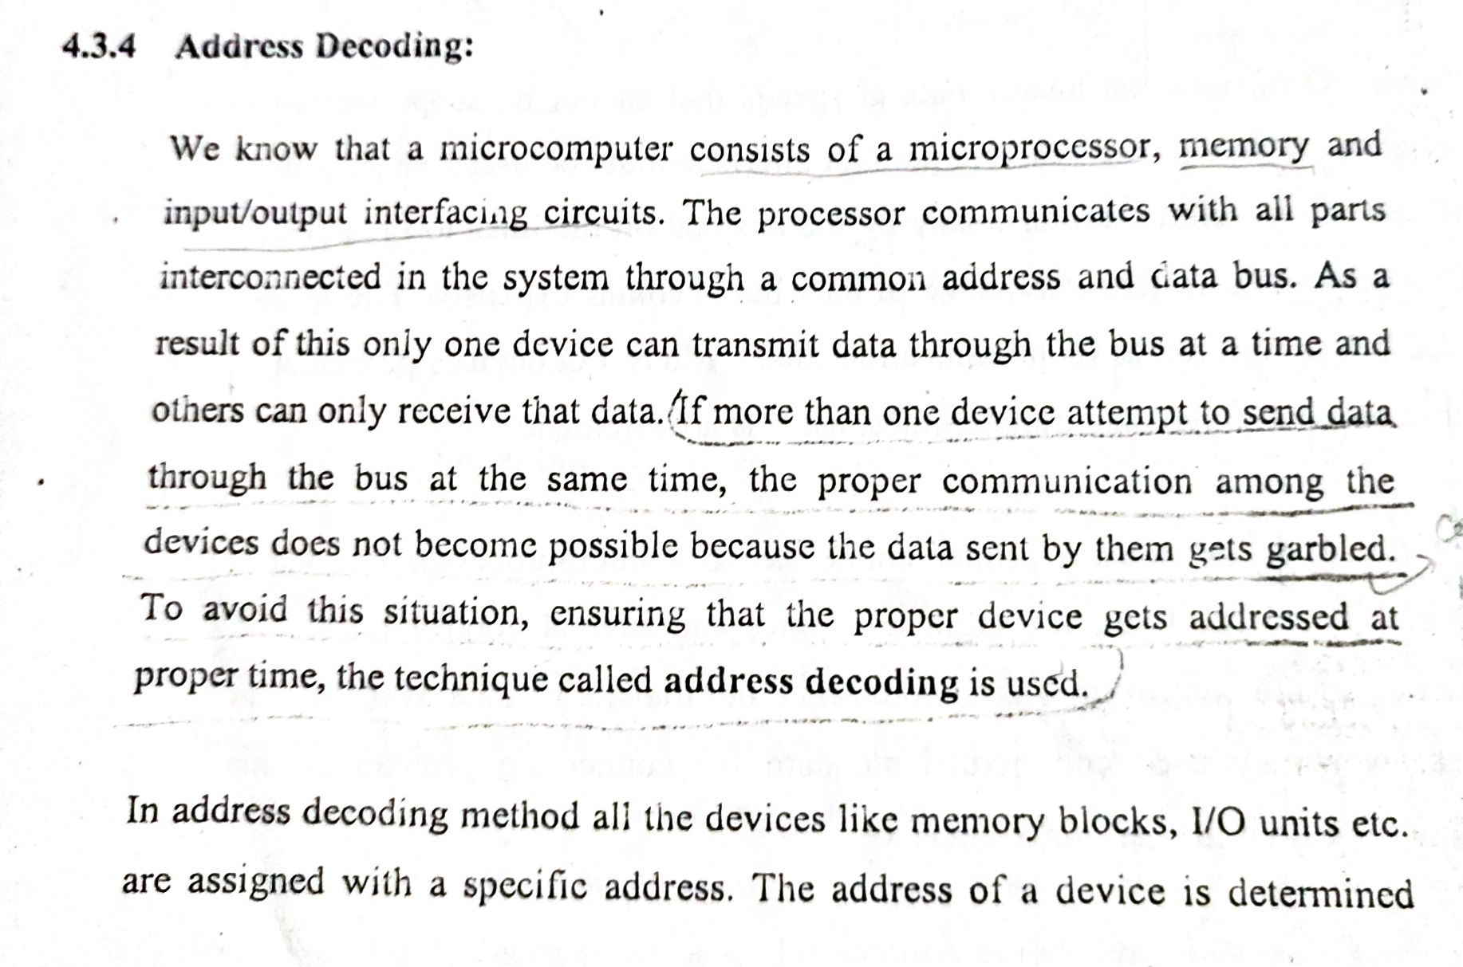
Microprocessor……..

Slide 2
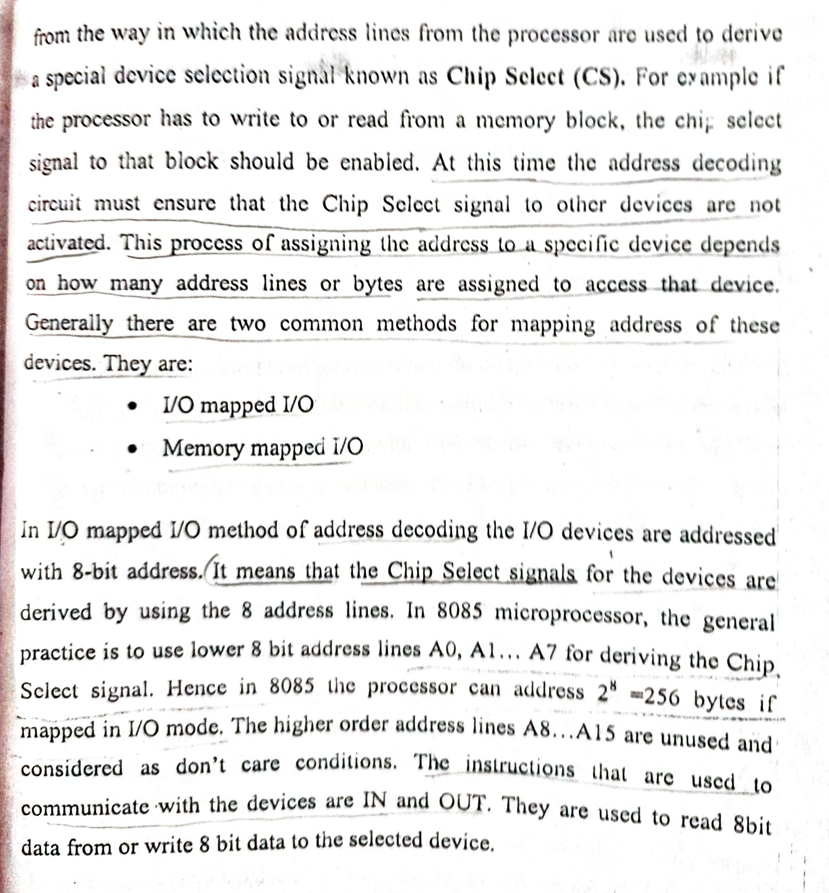
Microprocessor……..

Slide 3
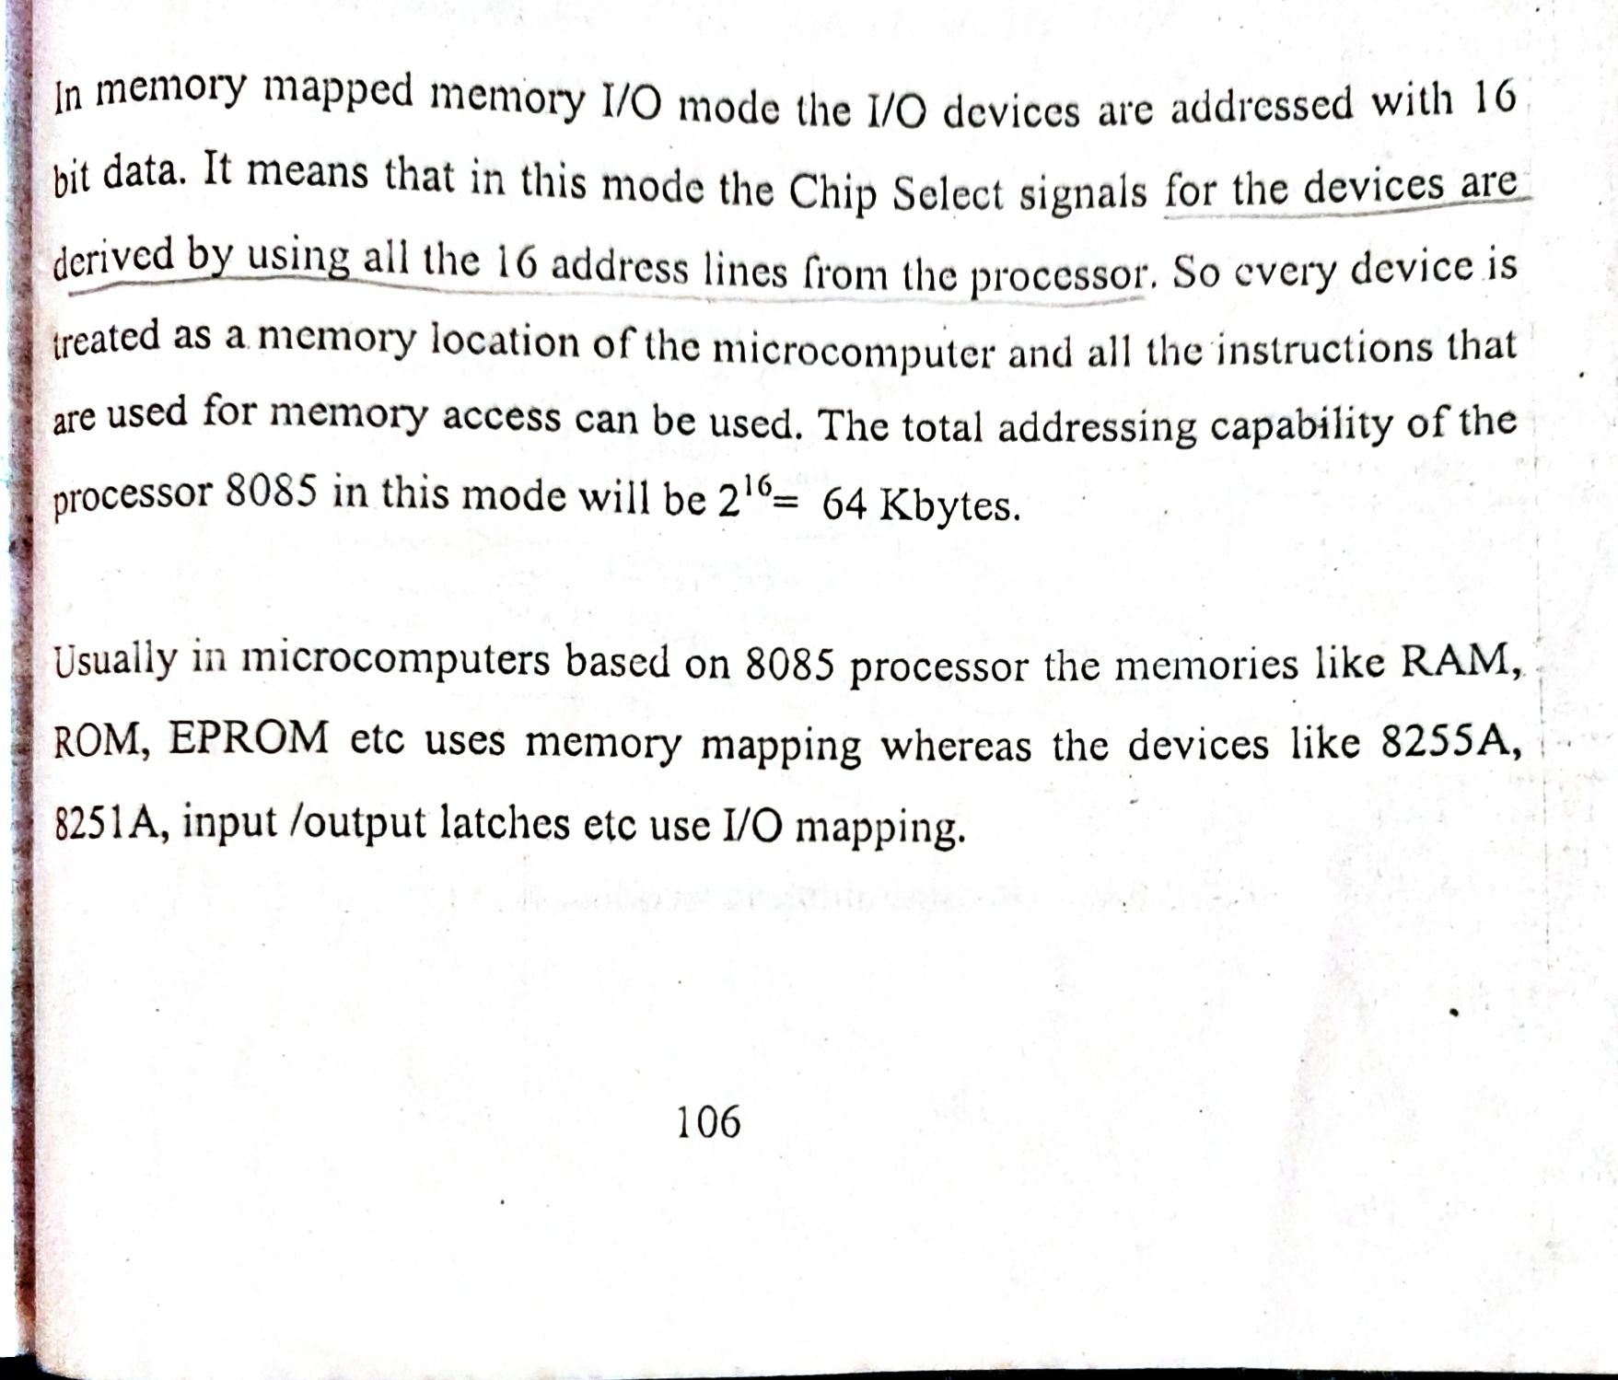
Microprocessor……..

Slide 4
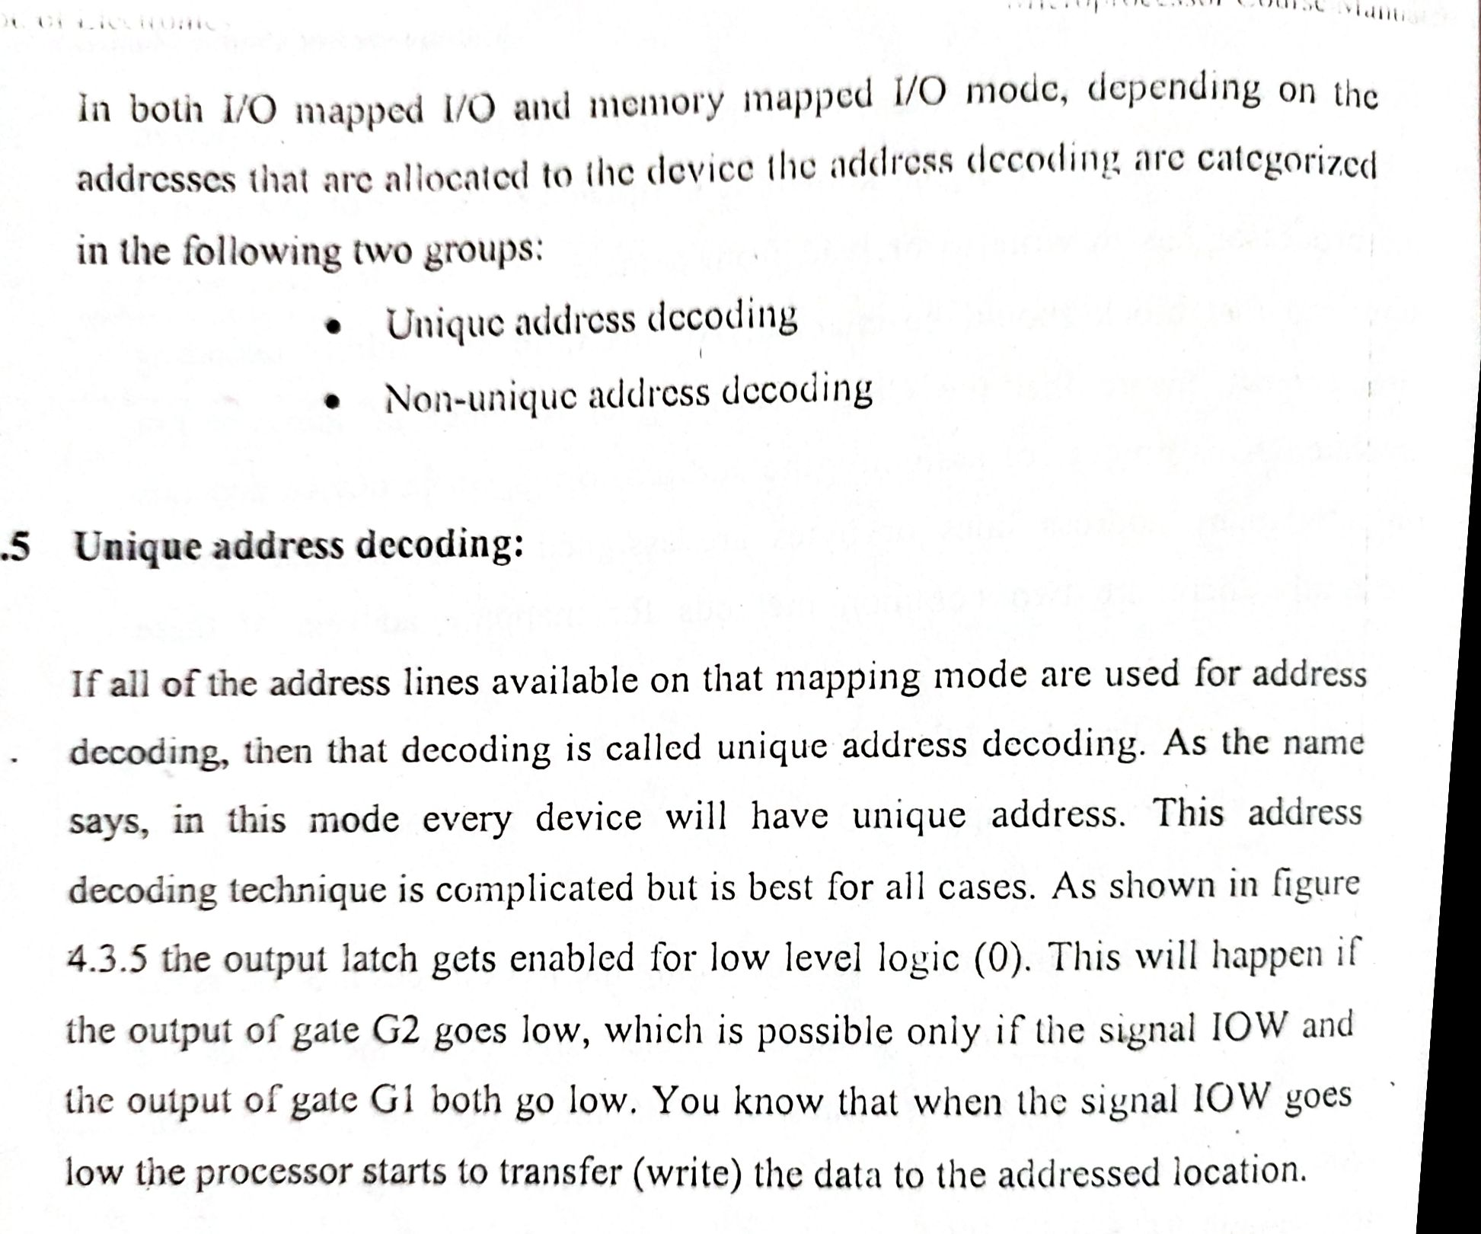
Microprocessor……..

Slide 5
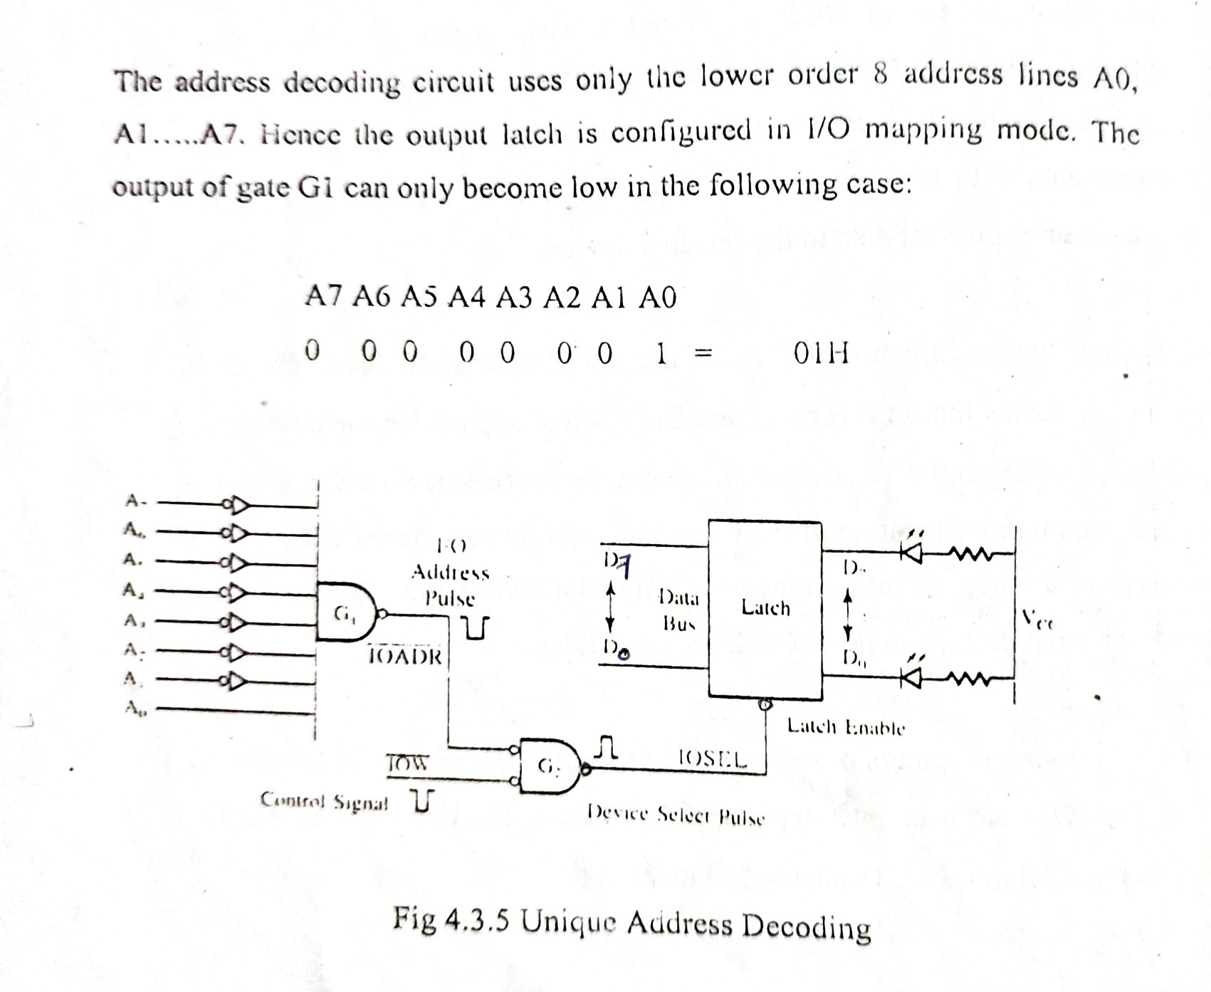
Microprocessor……..

Slide 6
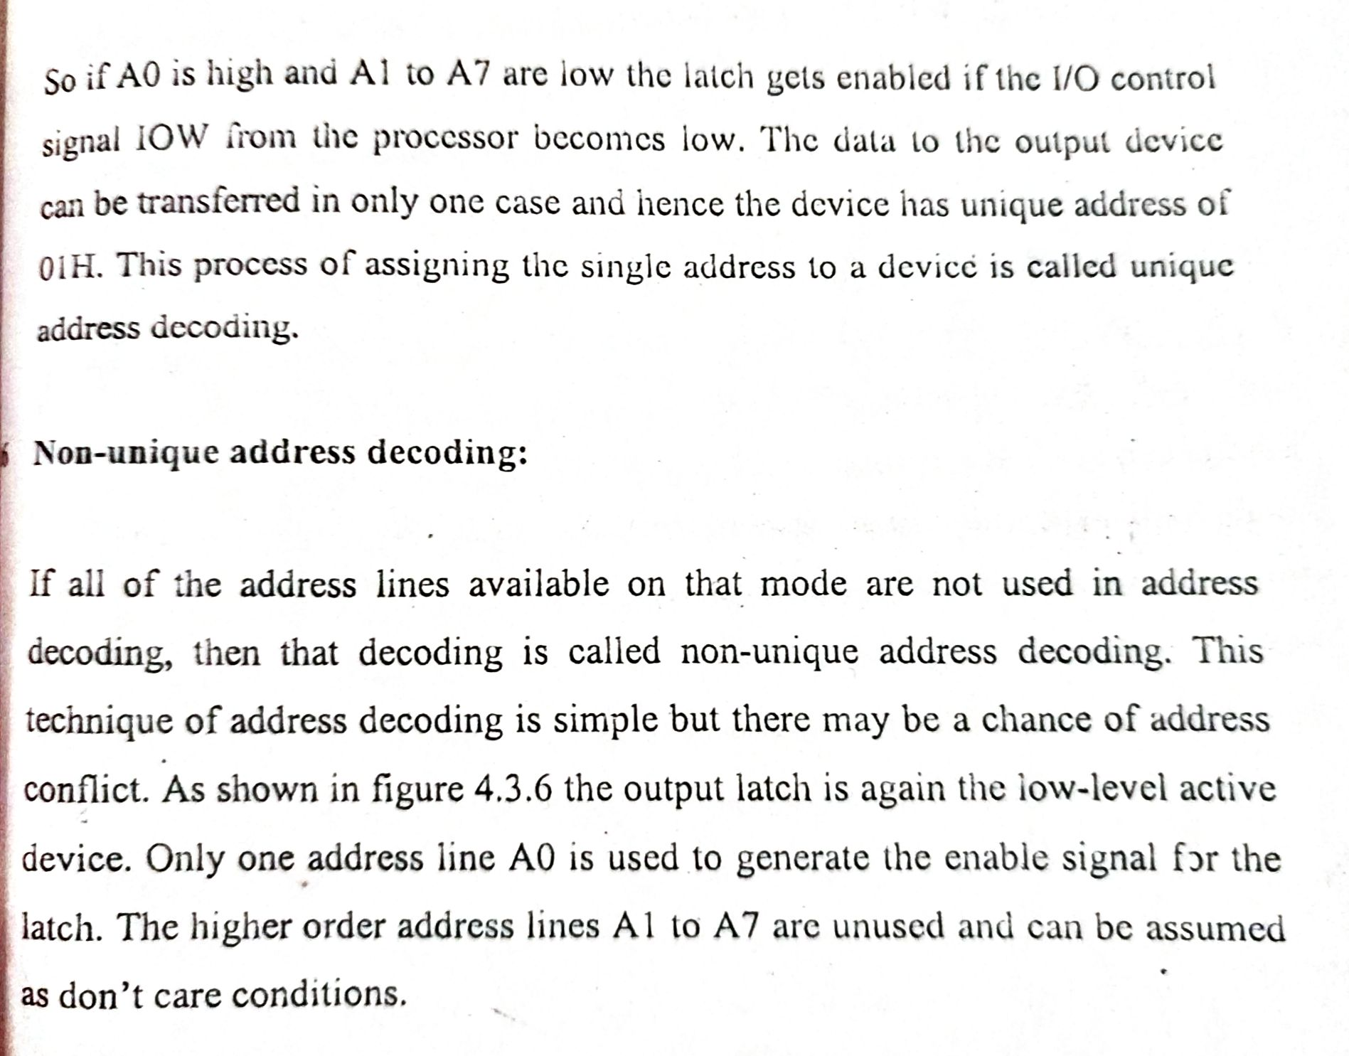
Microprocessor……..

Slide 7
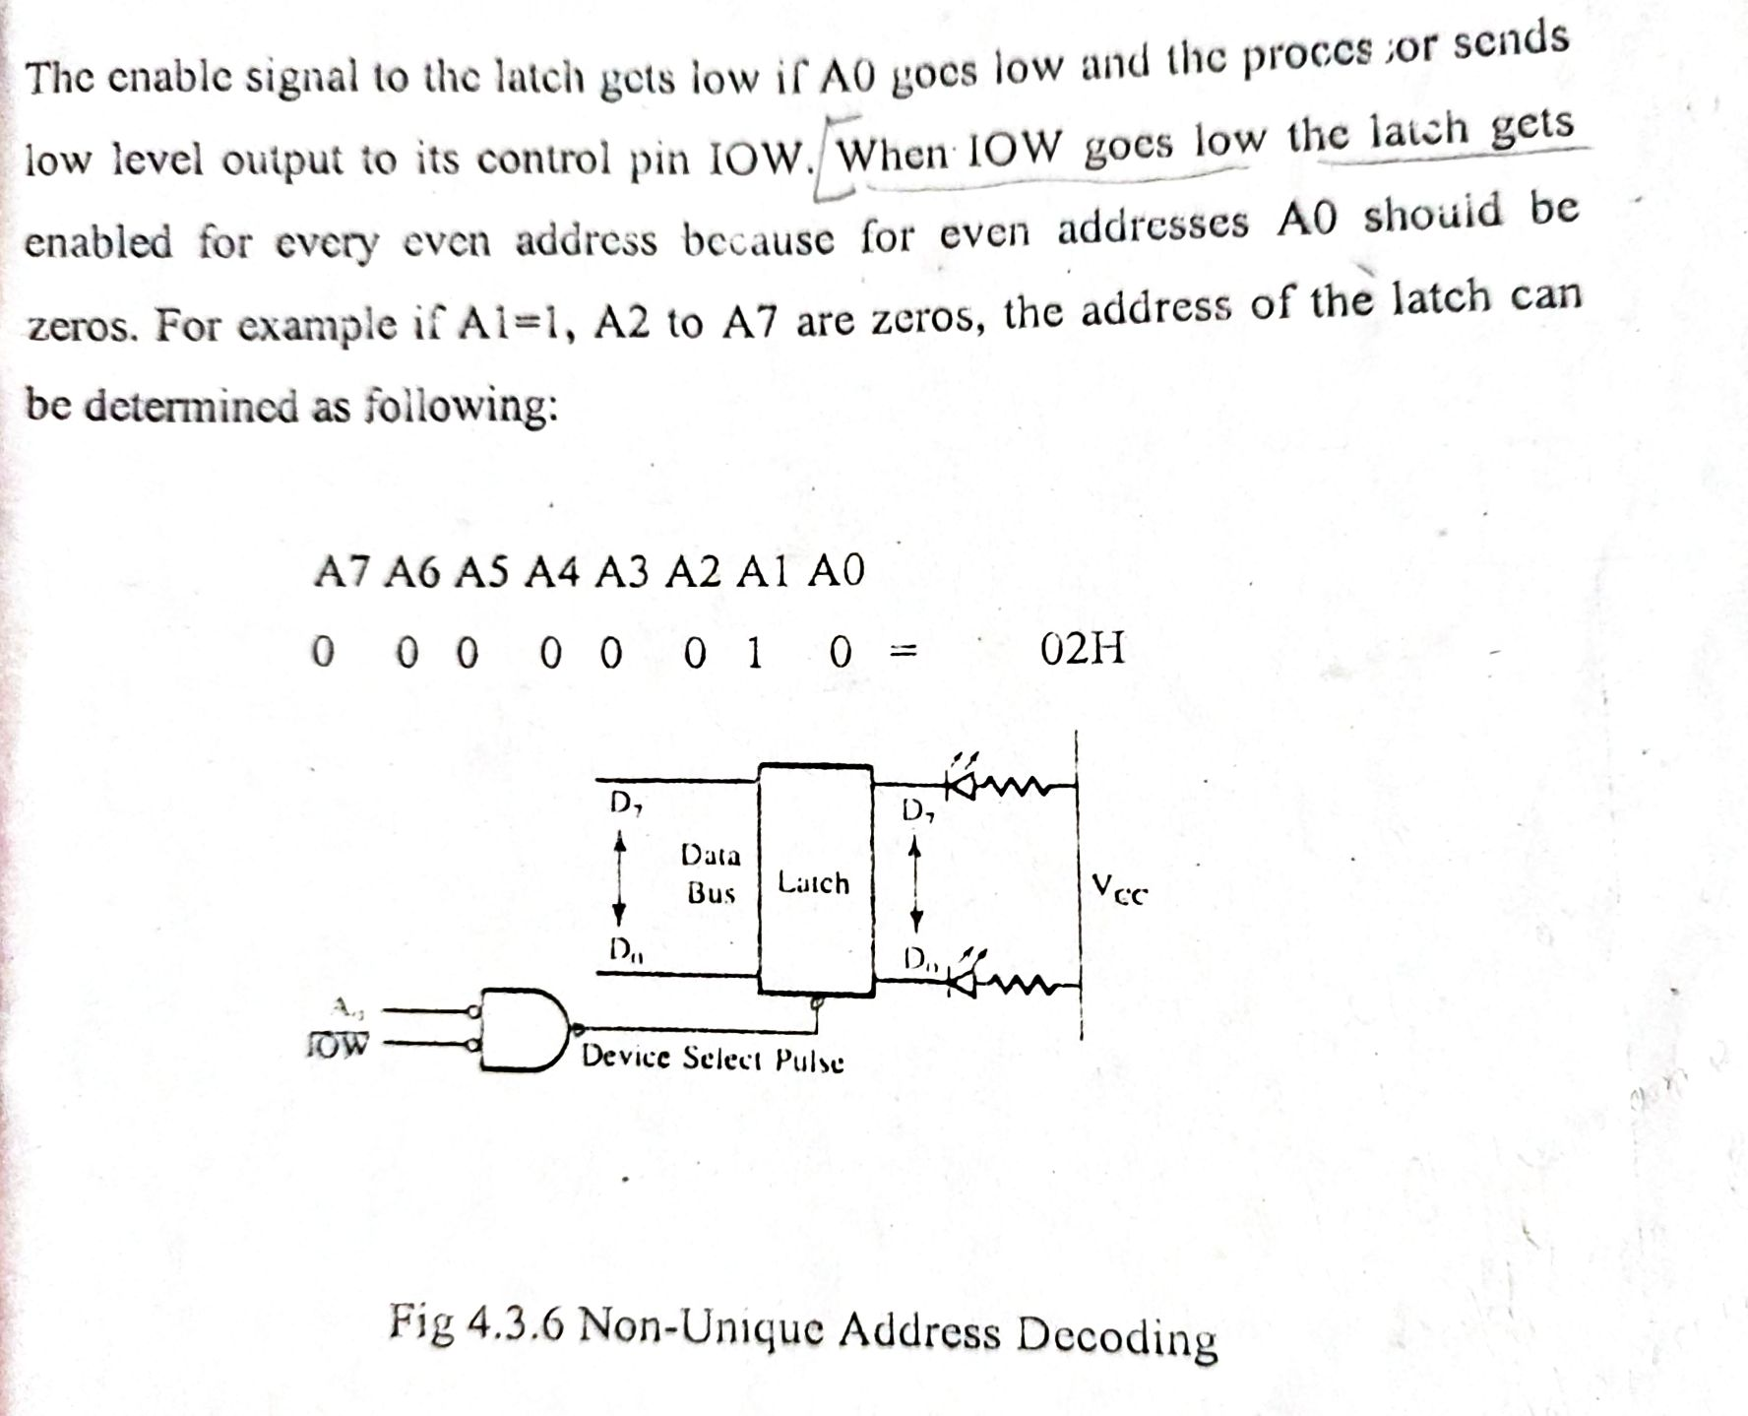

Microprocessor……..

Slide 8
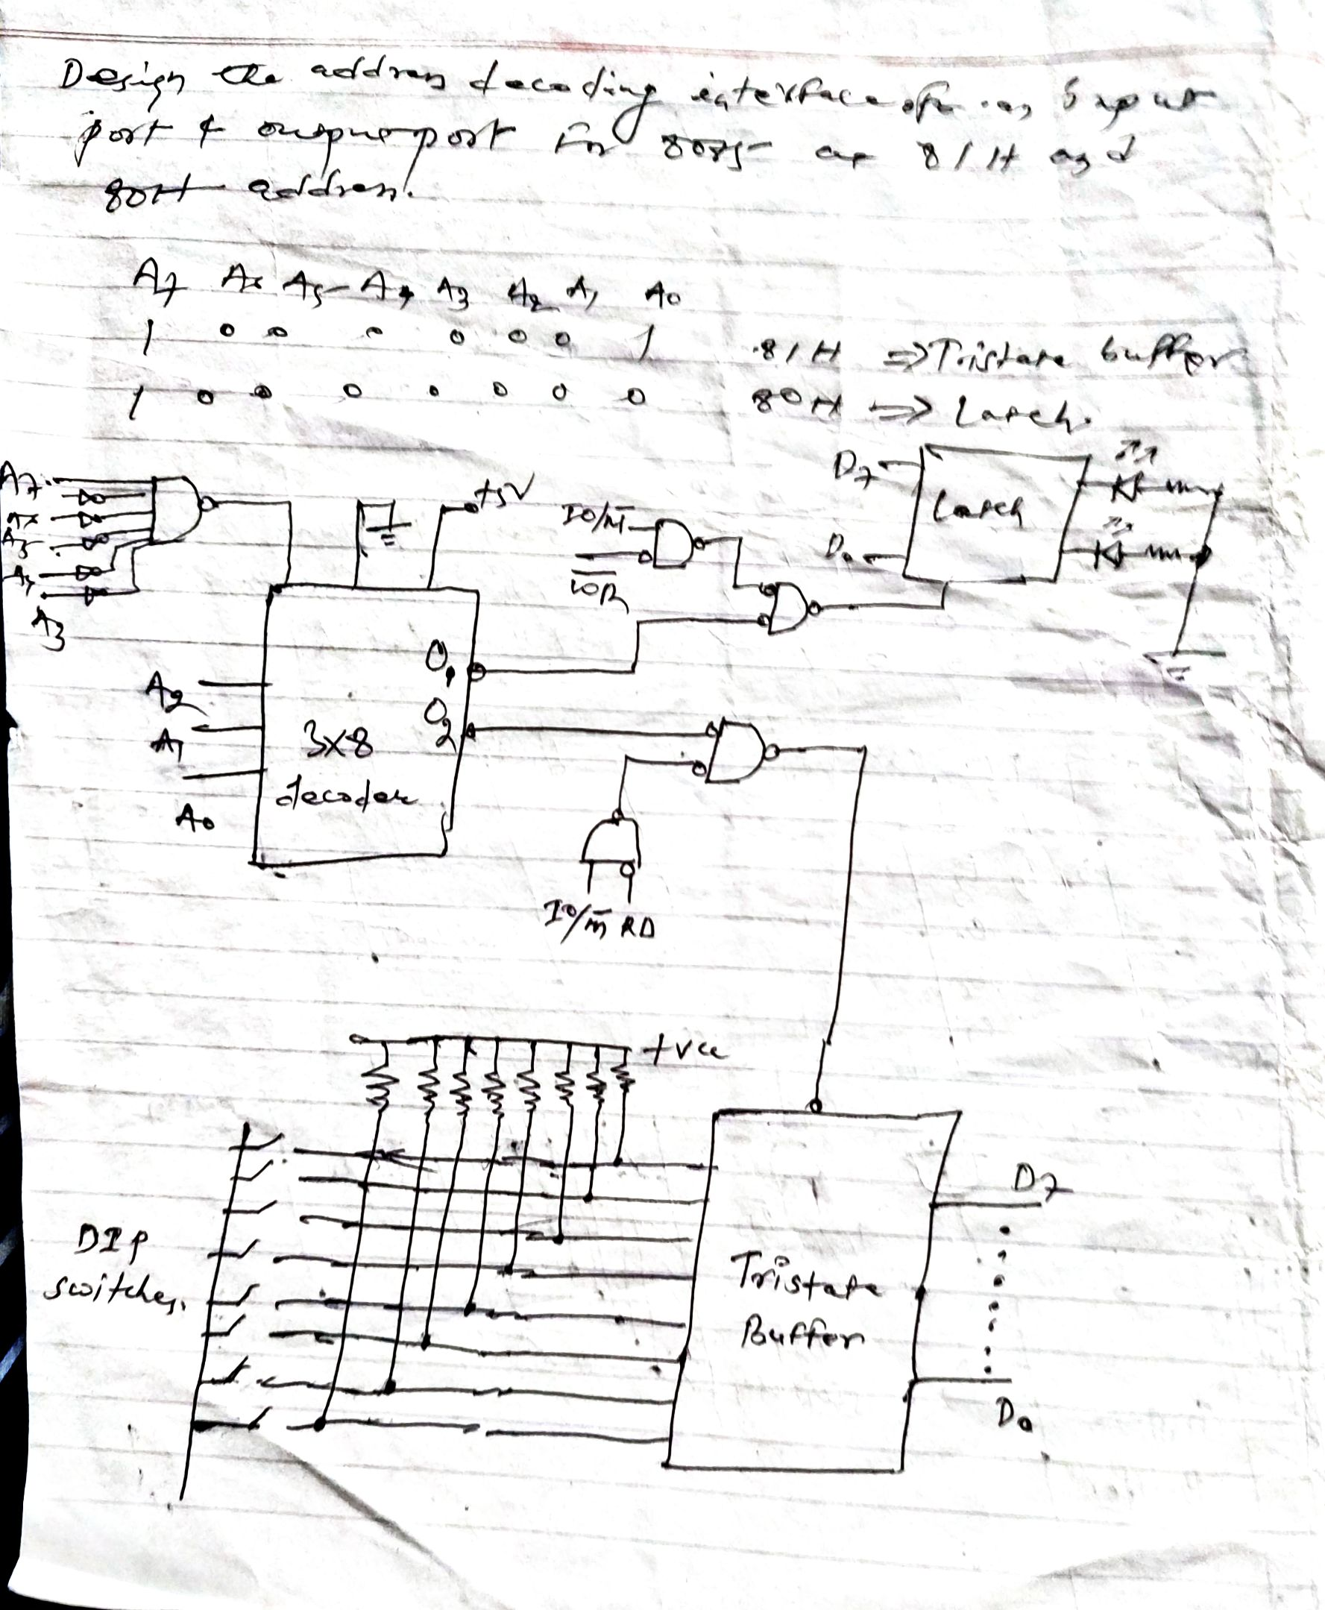
Microprocessor……..

Slide 9
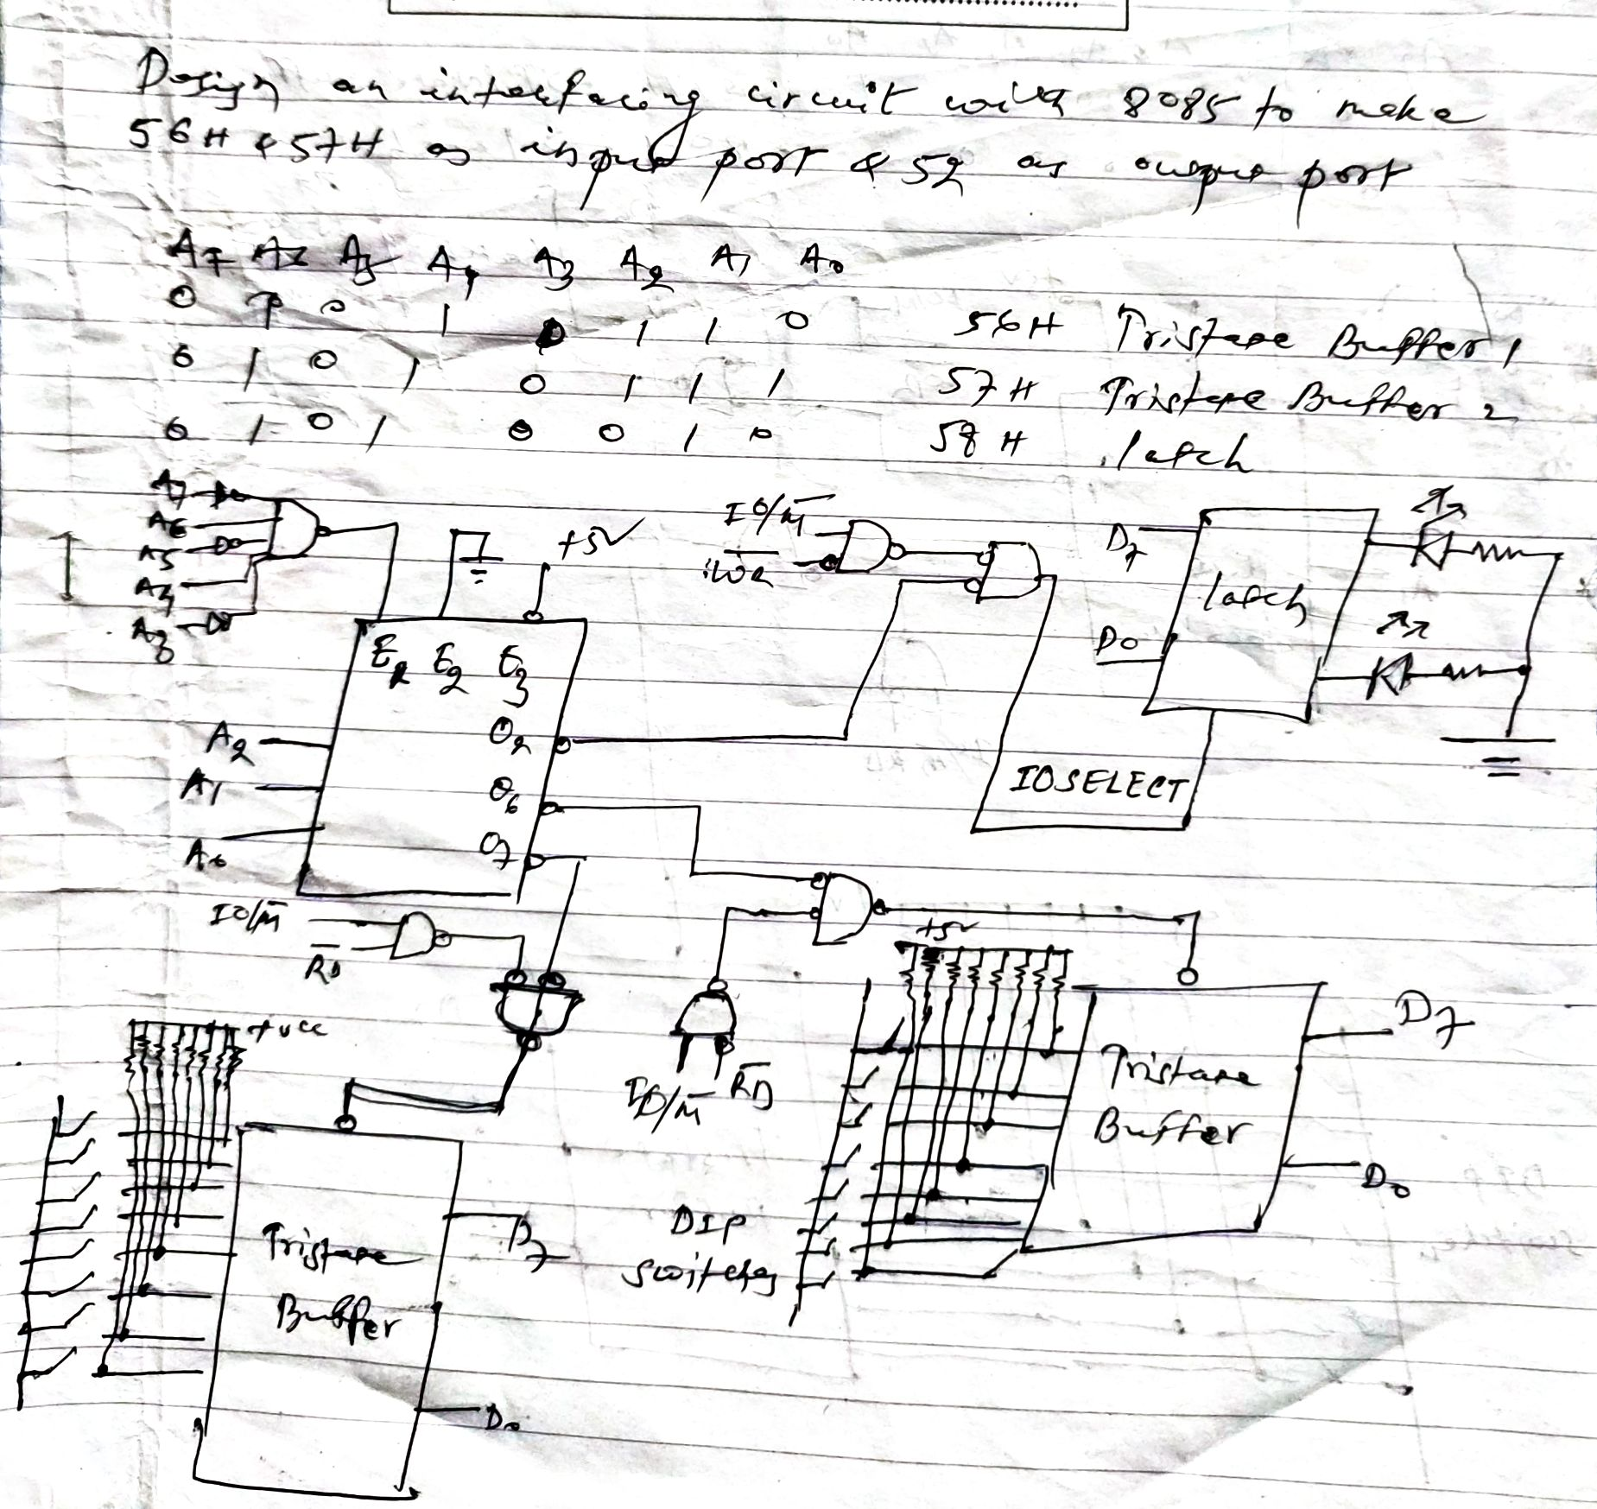
Microprocessor……..

